Slide 1
Activity 1: Color segmentation
Physics 301
Submitted by: Mark Jeremy G. Narag
Student Number: 2014-64423
Program: PhD Physics

Slide 2

Color segmentation
Objectives:
Use digital color histograms to segment regions of interest in an image
Demonstrate how color changes under varying illumination

Slide 3
Color segmentation
Thresholding
Short introduction and matlab code
Results
Parametric segmentation
Short introduction and matlab code
Results
Non-parametric segmentation
Short introduction and matlab code
Results
Conclusion

Slide 4
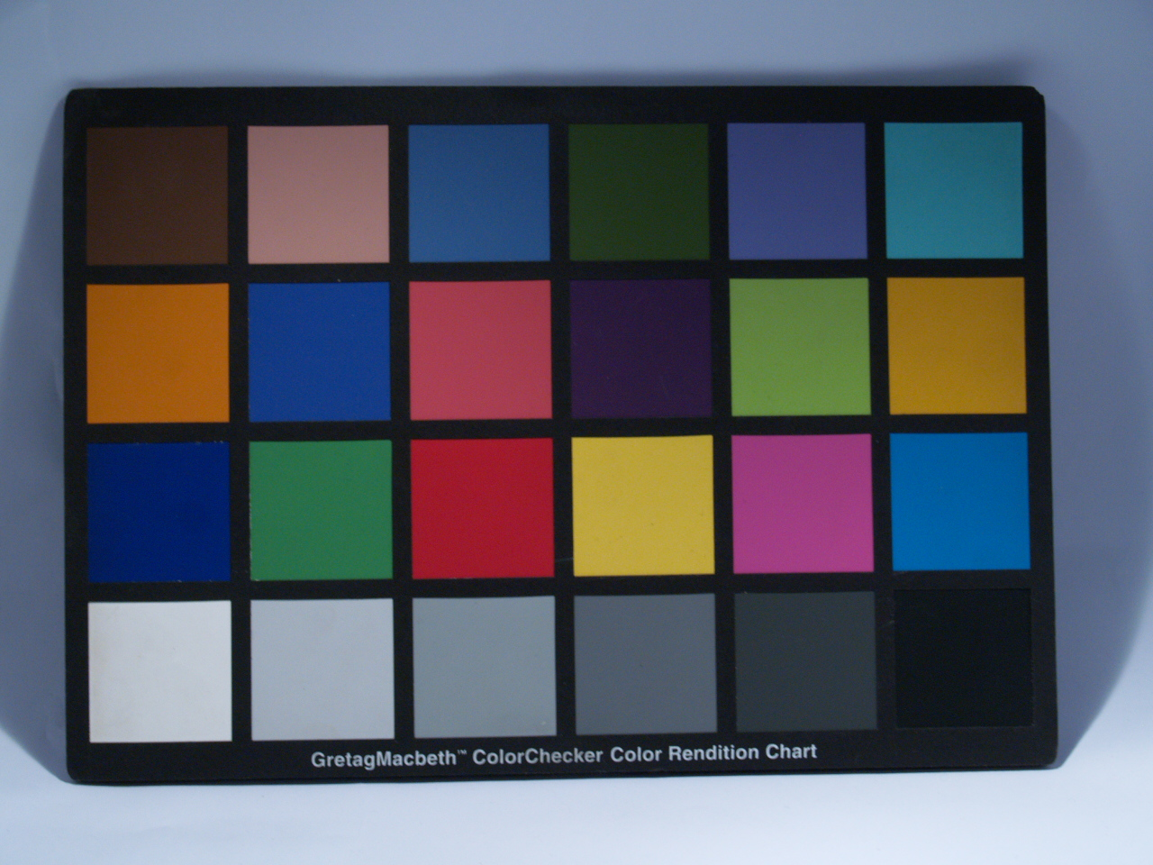
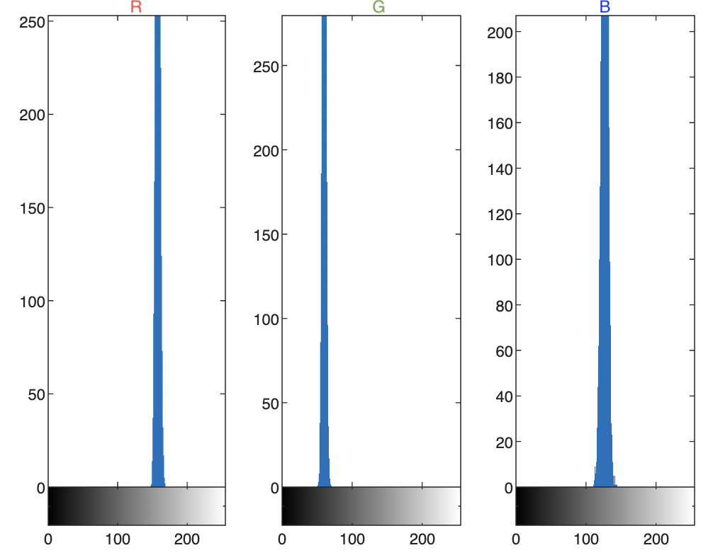
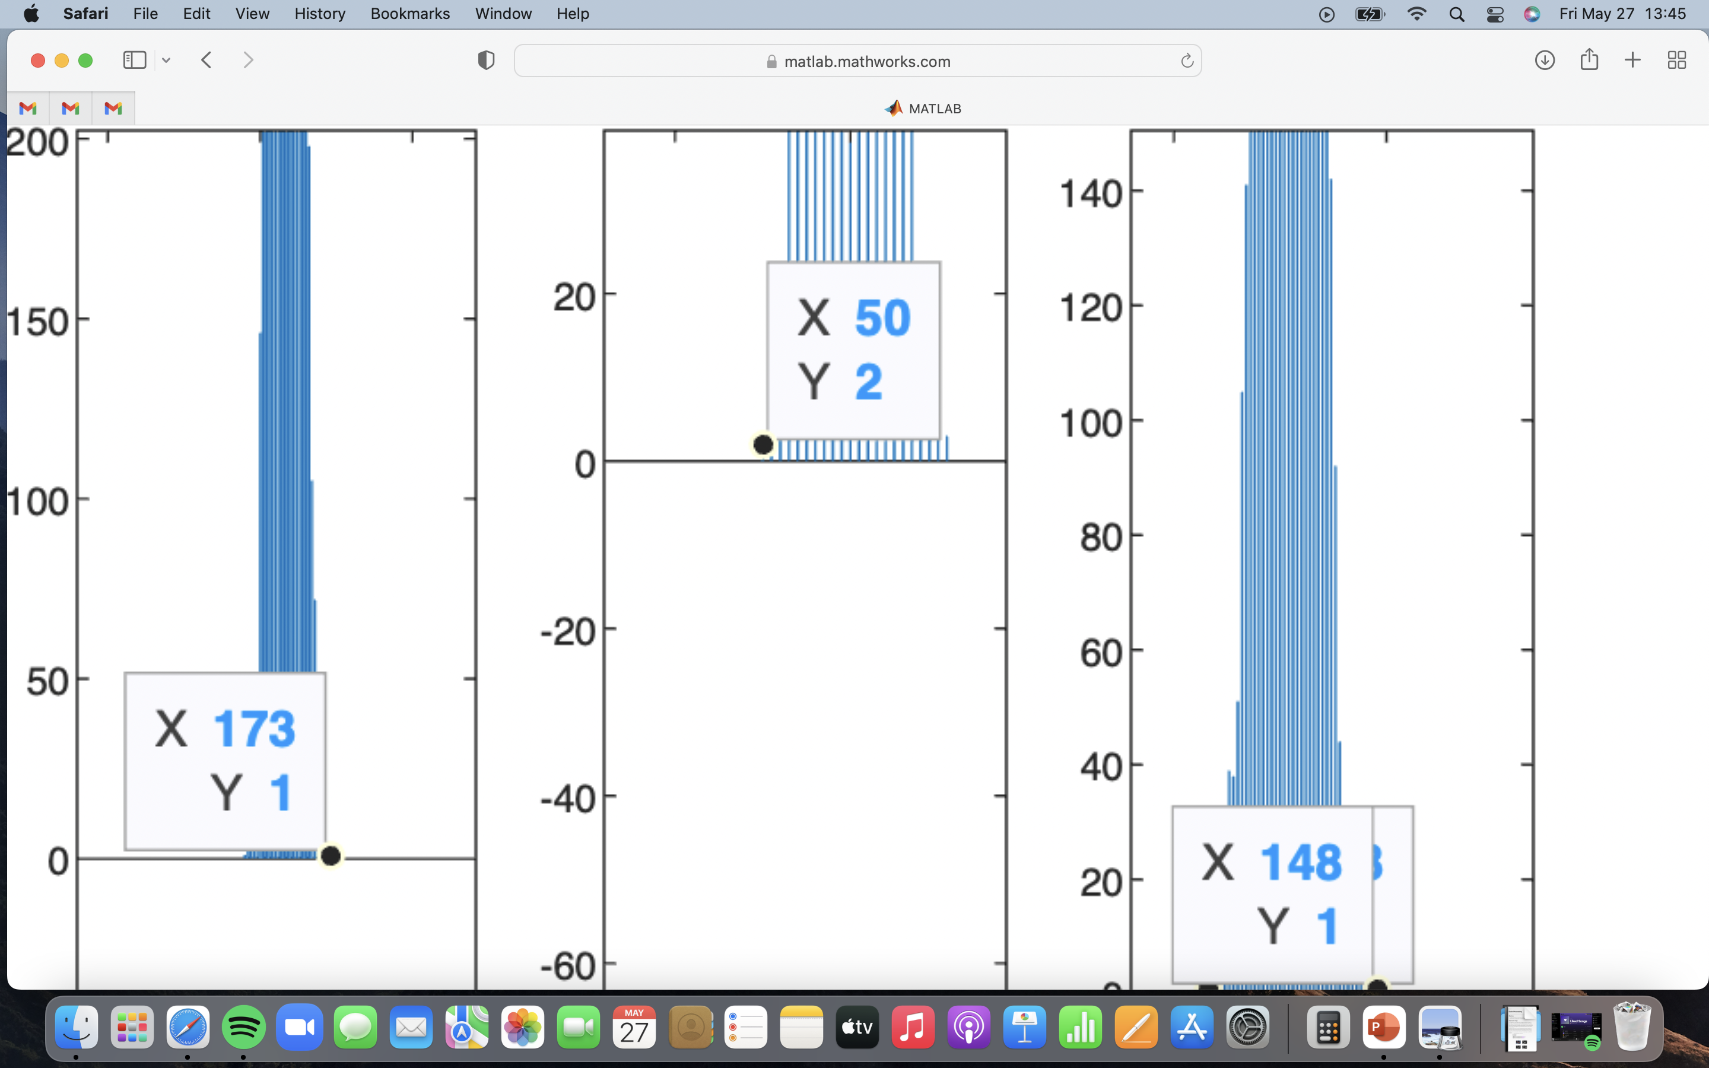
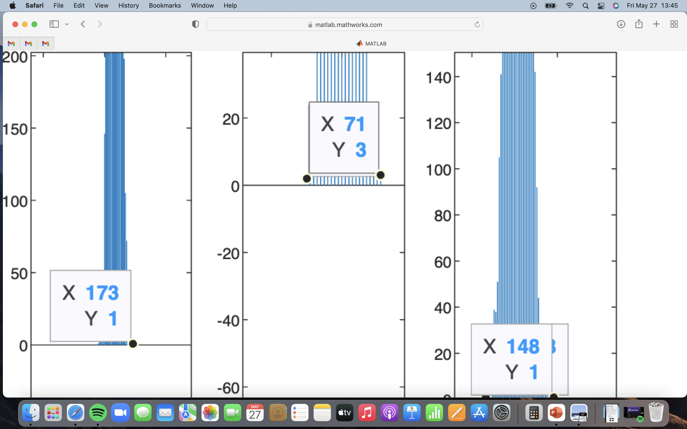
Method 1: Thresholding
Color has three histogram channels - Red, Green, and Blue. In simple cases where we want to isolate a region of interest in Macbeth chart below (Fig 1), we can simply note the range of the corresponding digital number the histograms are within (Fig 2).
Let’s say we want to isolate this box here. The color of the box has the following histogram. For example, to get the range in G-channel, we take note of both edges in the histogram. In this case, the range is 50 to 71.
Fig 1. Macbeth Chart
-
Fig 2. Histogram color channel. X-axis ranges from 0 to 255. The red arrow heads are the locations to take note.

Slide 5
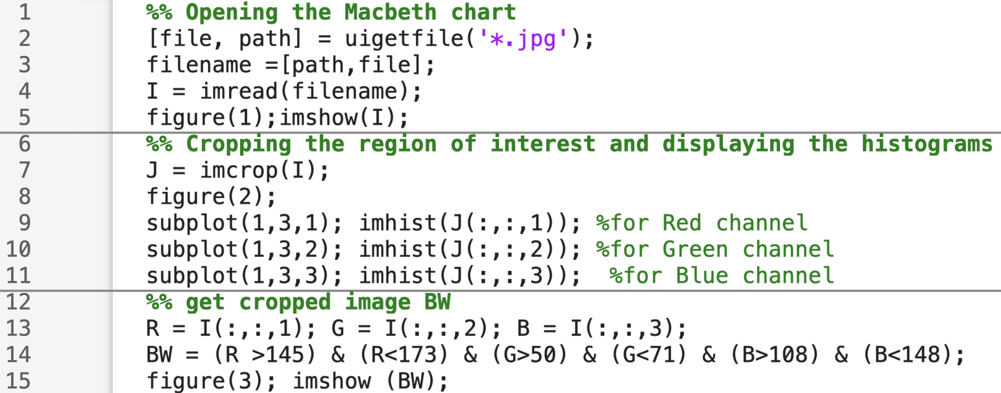
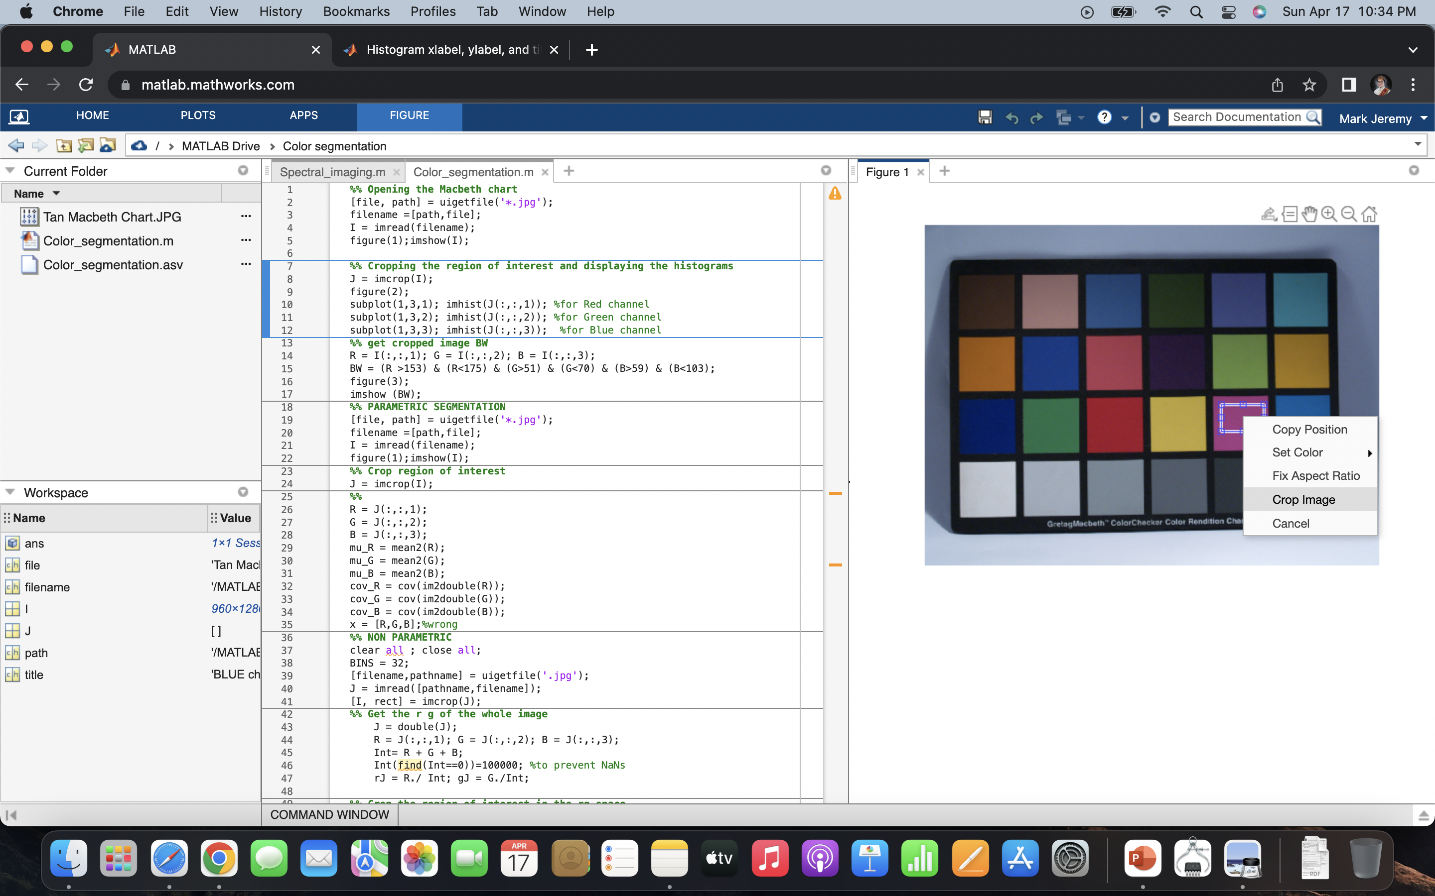
Method 1: Thresholding
- In matlab, this is how you do it:
In line 7, you will need to manually select a portion of the ROI, right click, then choose crop image:
Q: How big should you crop? A: Really depends on the situation. Since this is a relatively simple homogenous box, a small portion can suffice.
In line 13, we separate the image I into three channels.
In line 14, we apply a logical operation (1 or 0) to threshold and display it as a black and white image.
This will output the histogram we saw in the previous slide.
Sanity check:

Slide 6


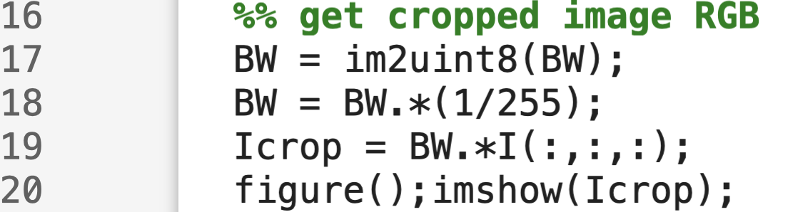
Method 1: Thresholding
Here’s the result of BW. Remember that it is 1 or 0 so it will output black and white only:
Of course, we want to get the segmented region in its original form (RGB). Here, what I did is to multiply logical operation BW to the original image per channel, element-by-element:
In line 16, I converted it first to uint8 since the element-by-element matrix multiplication wont work if the two matrices are of different class. It will give you [0,255] so we need to divide it each cell to 255 to get [0,1].
Here’s the final output:

Slide 7
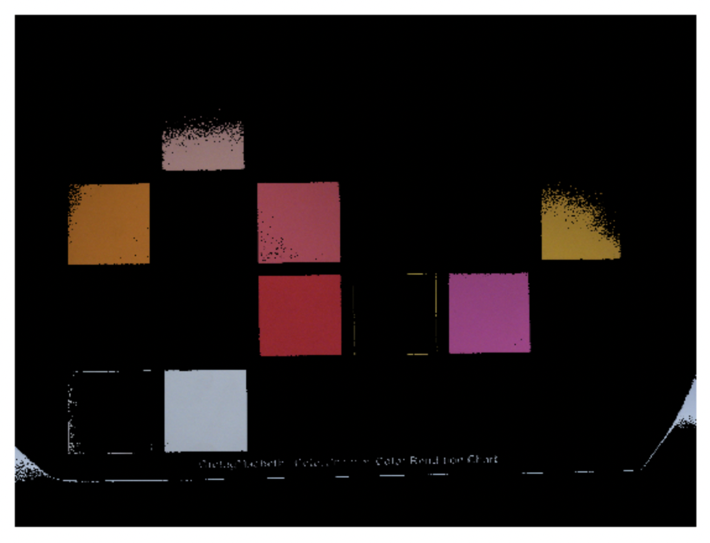
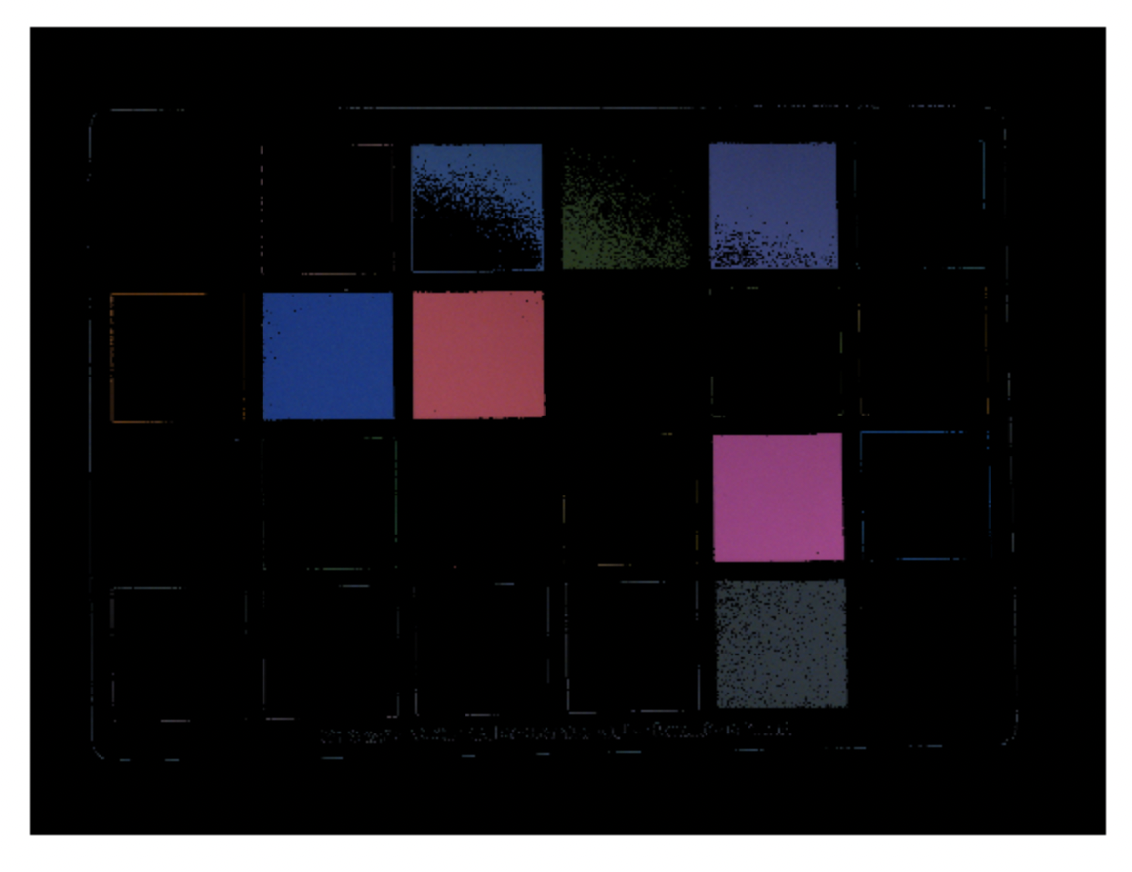
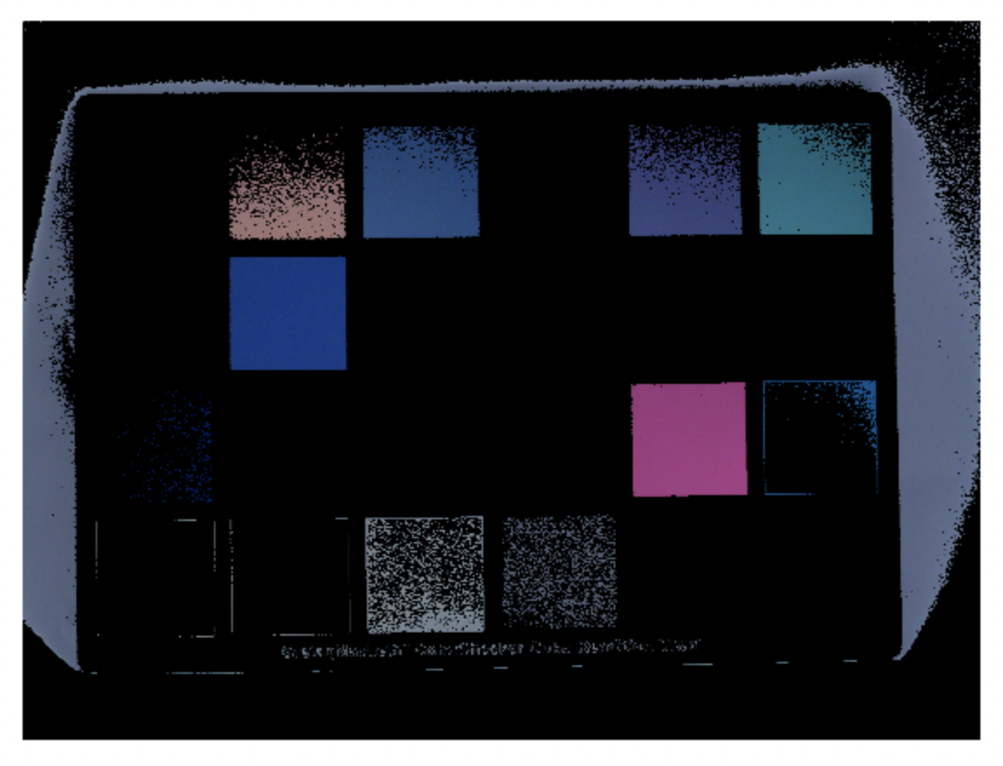
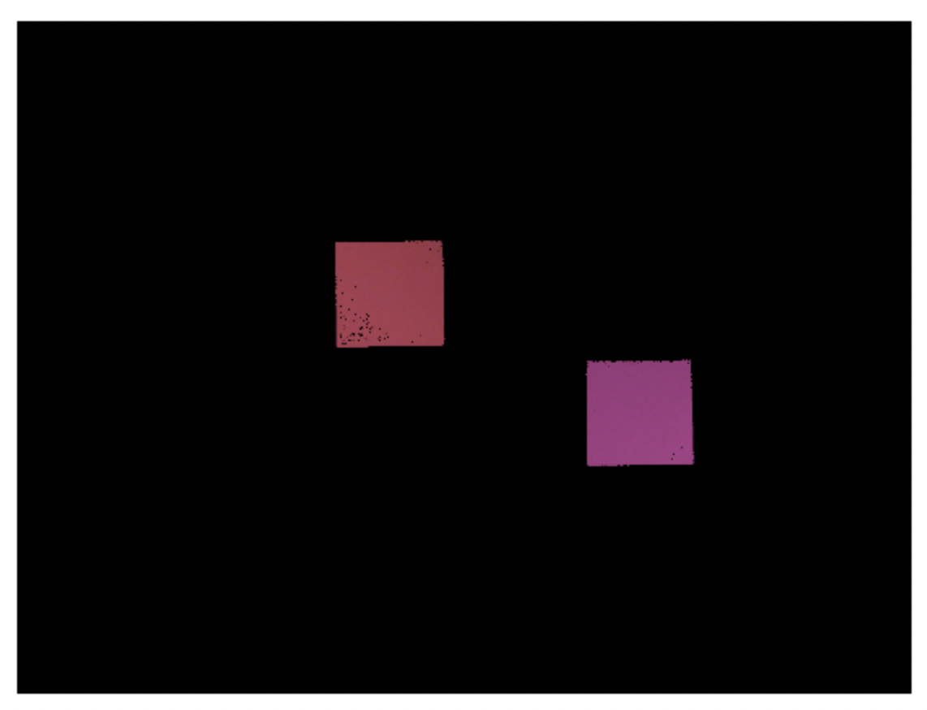
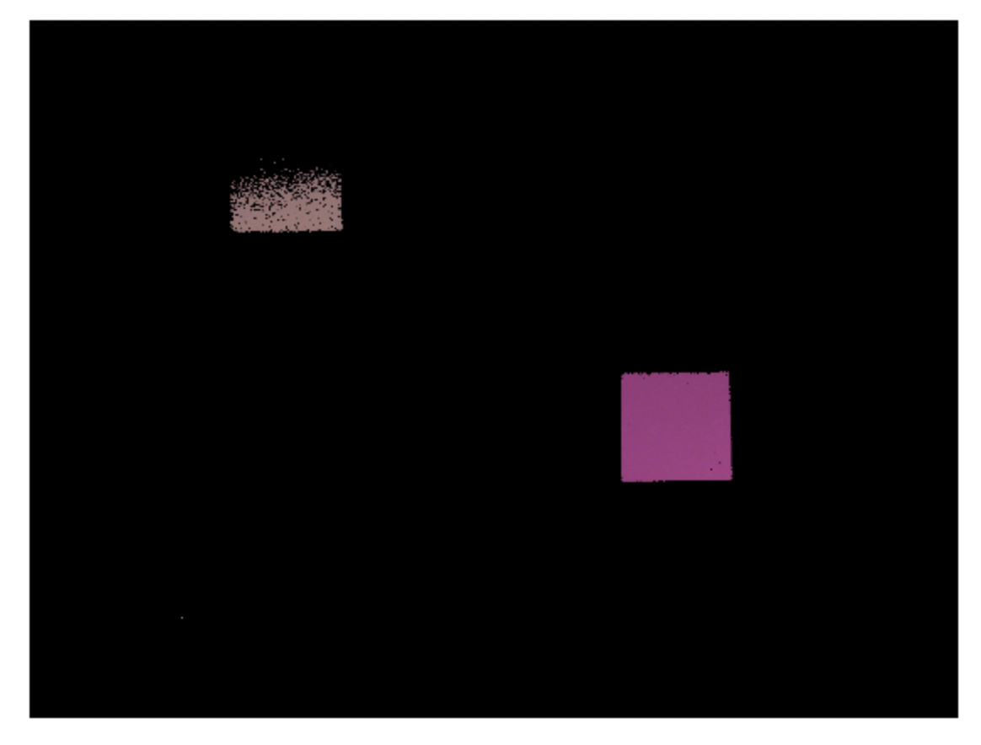
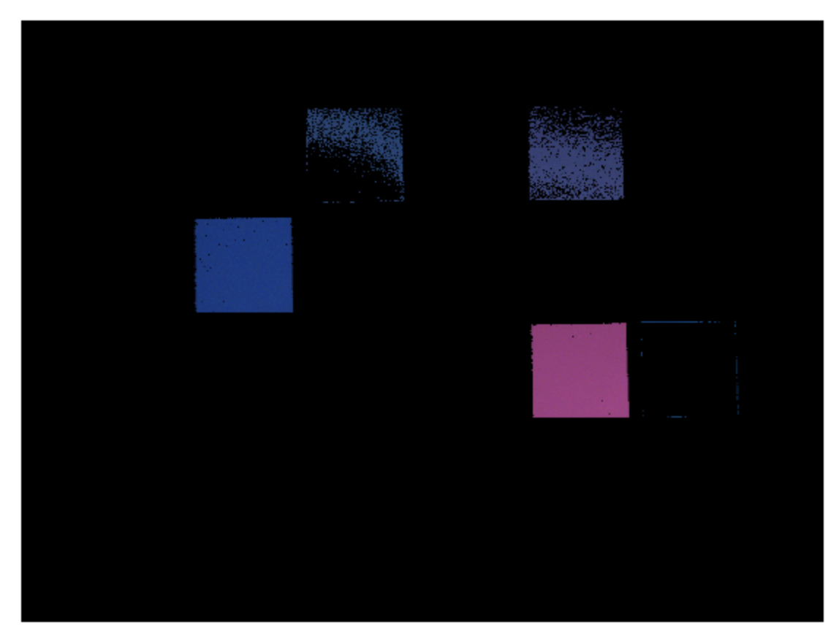
Method 1: Thresholding
It is important to threshold on the three channels, otherwise, we will get these segmented regions:
Threshold on R channel only
Threshold on G channel only
Threshold on B channel only
Threshold on R and G channels only
Threshold on R and B channels only
Threshold on G and B channels only

Slide 8
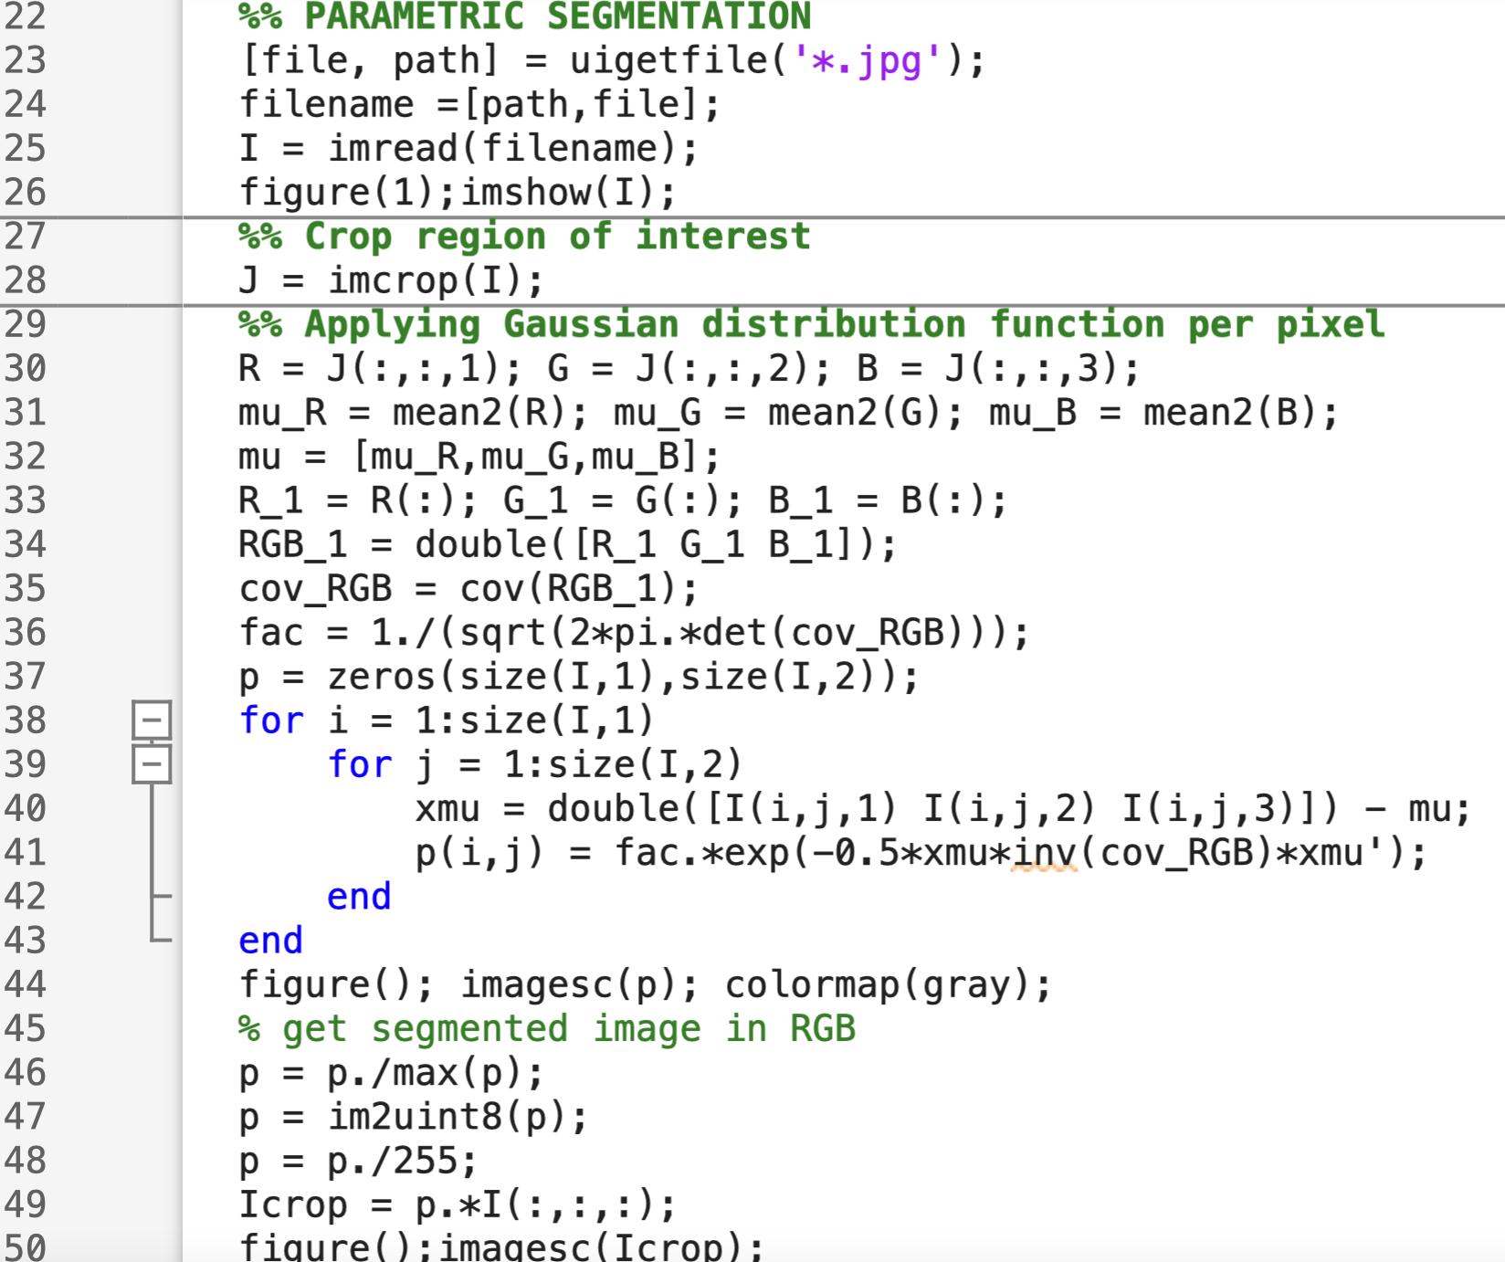
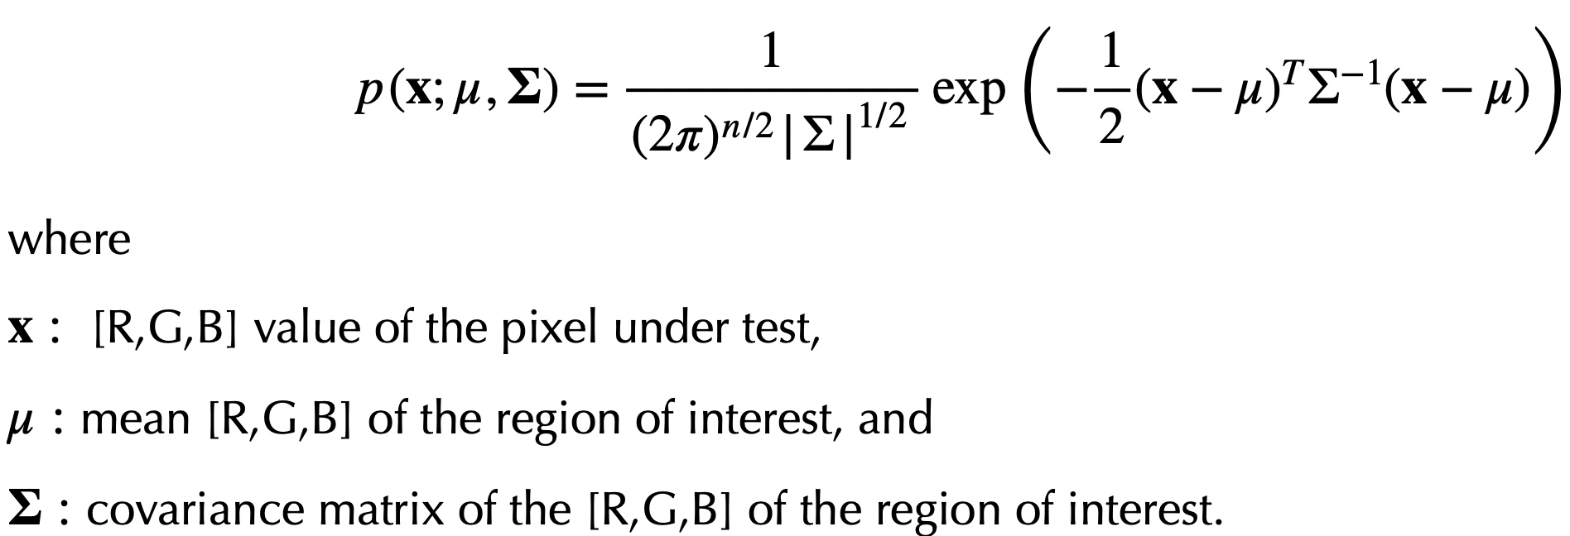
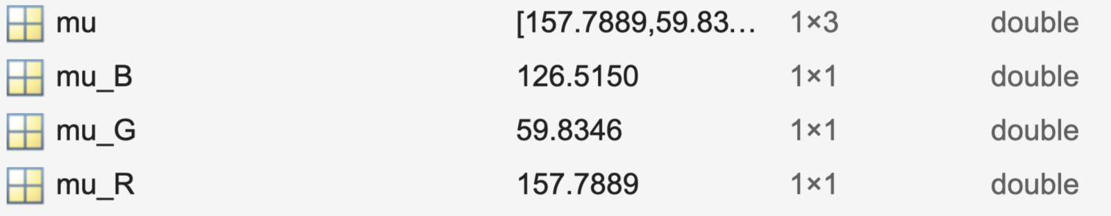
Method 2: Parametric Segmentation
In Method 1, we segmented the ROI by getting the bounds of the color histogram. Here in Method 2, we will model the color histogram by a distribution function, in particular, a multivariate Gaussian distribution function:
For each pixel, we will apply the probability distribution above. It will output how similar the pixel is to the ROI. The higher the probability, the brighter the pixel is.
The Matlab code above is pretty straightforward:
Sanity check:

Slide 9
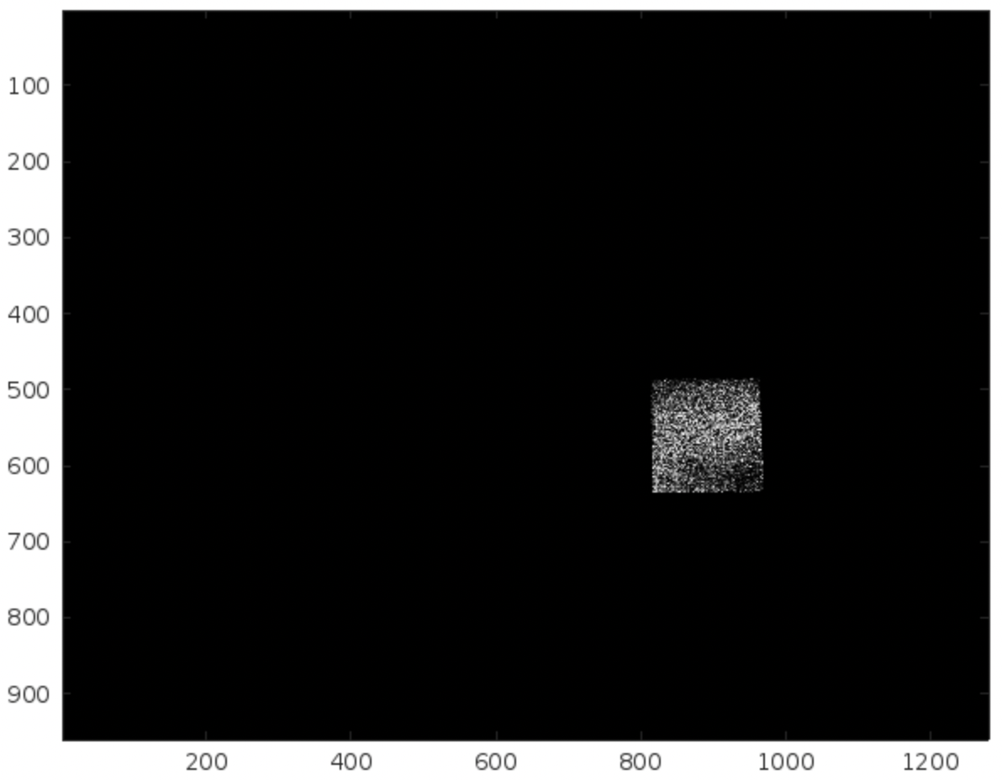
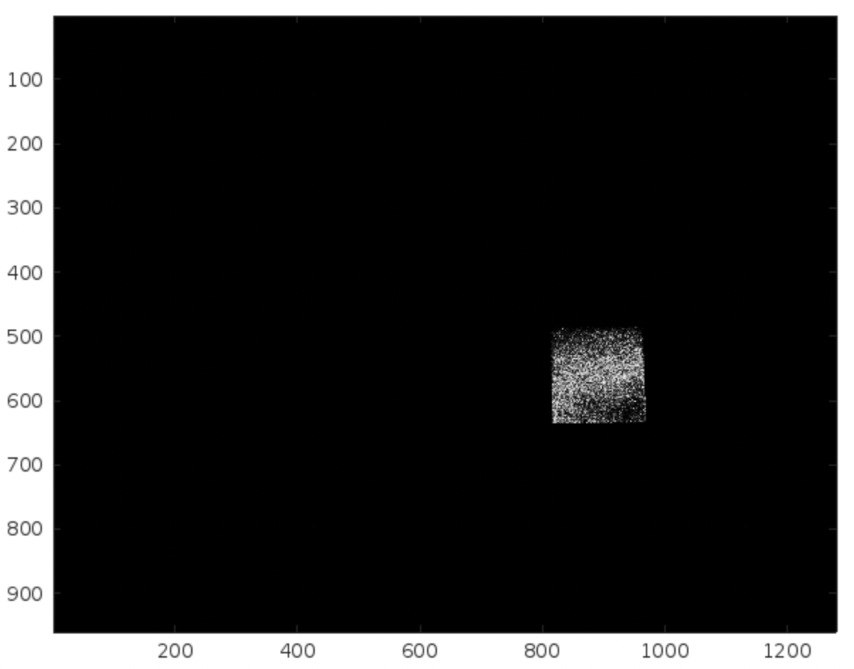
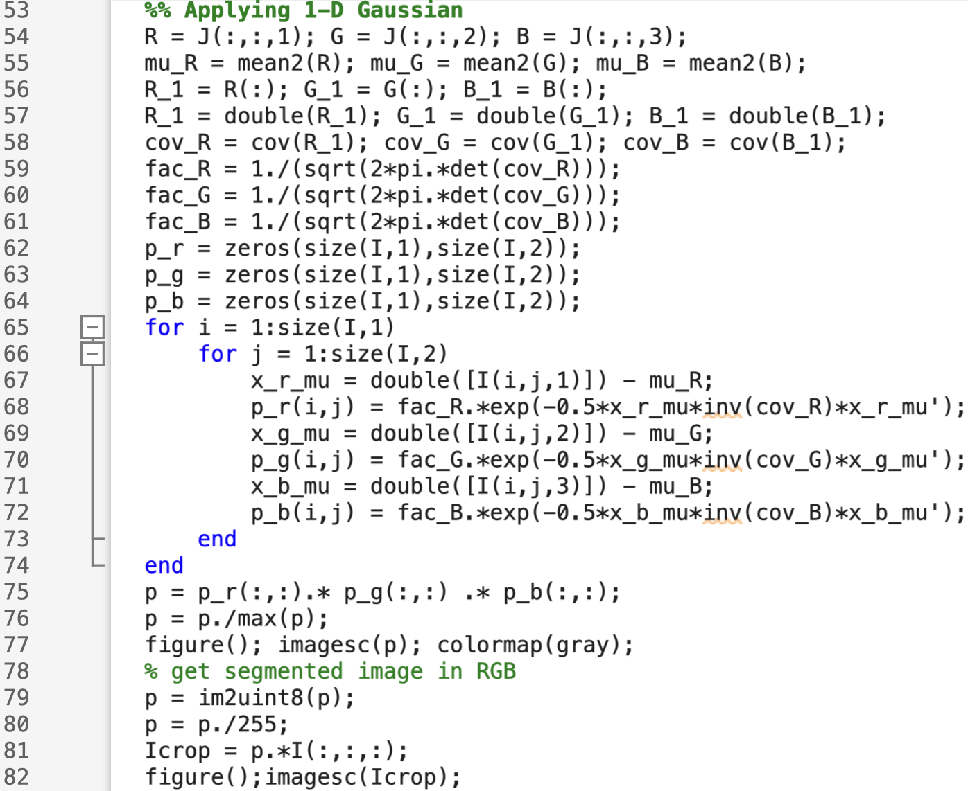
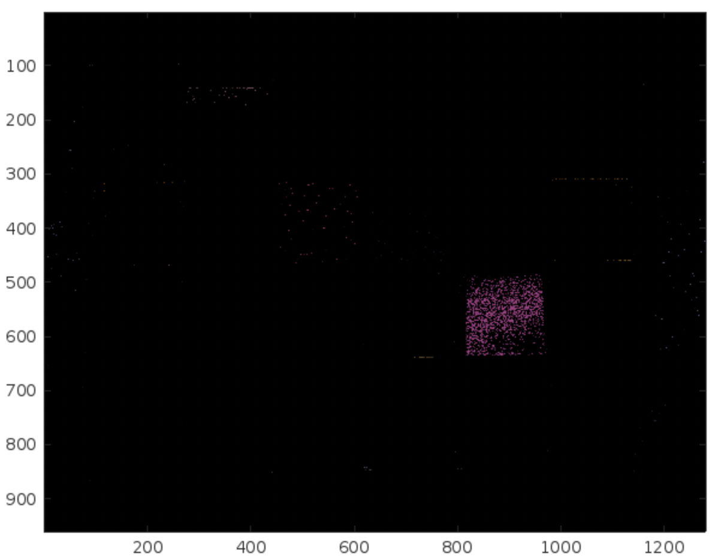
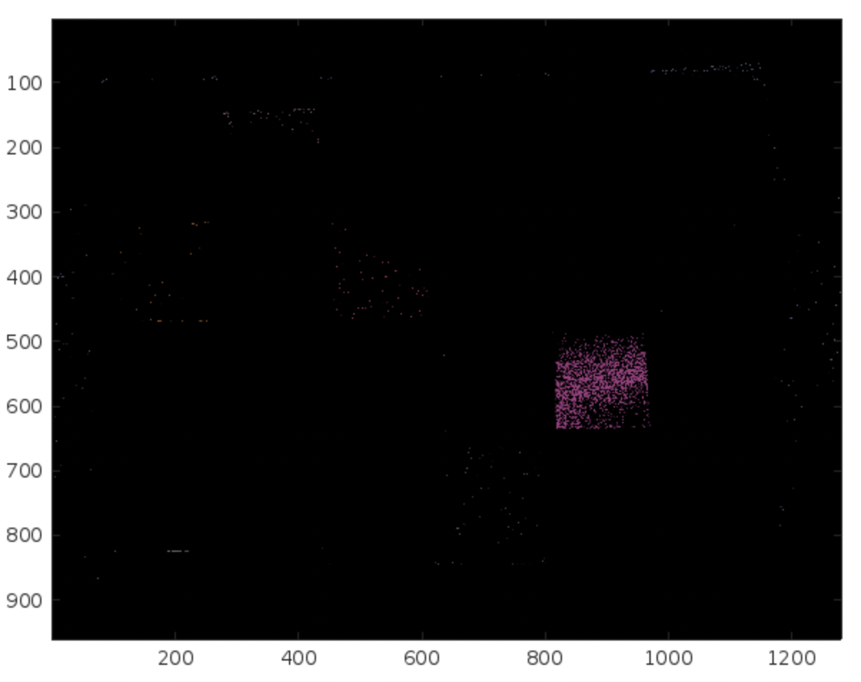
Method 2: Parametric Segmentation
Result of Method 2. As we can see, thresholding beats parametric segmentation
Let’s try to improve it through a joint 1-D Gaussian distribution per channel then we multiply the probabilities element by element of each channel
Result of Method 2. As we can see, thresholding beats parametric segmentation

Slide 10
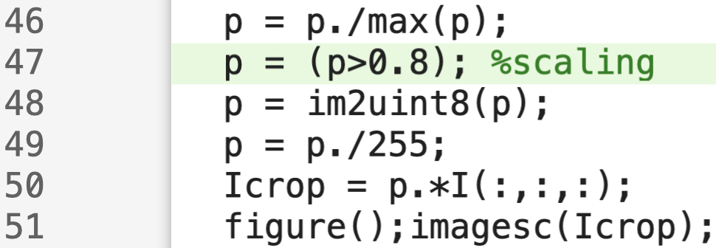
Method 2: Parametric Segmentation
Closeup difference of 3D versus 1D Gaussian probability distribution. Not much difference. Can we improve this?
3D Gaussian
1D Gaussian
I was thinking, what if we scale the probabilities? Say probabilities greater than X will be 1 and zero otherwise. We will just add a logical operation as in line 47:

Slide 11
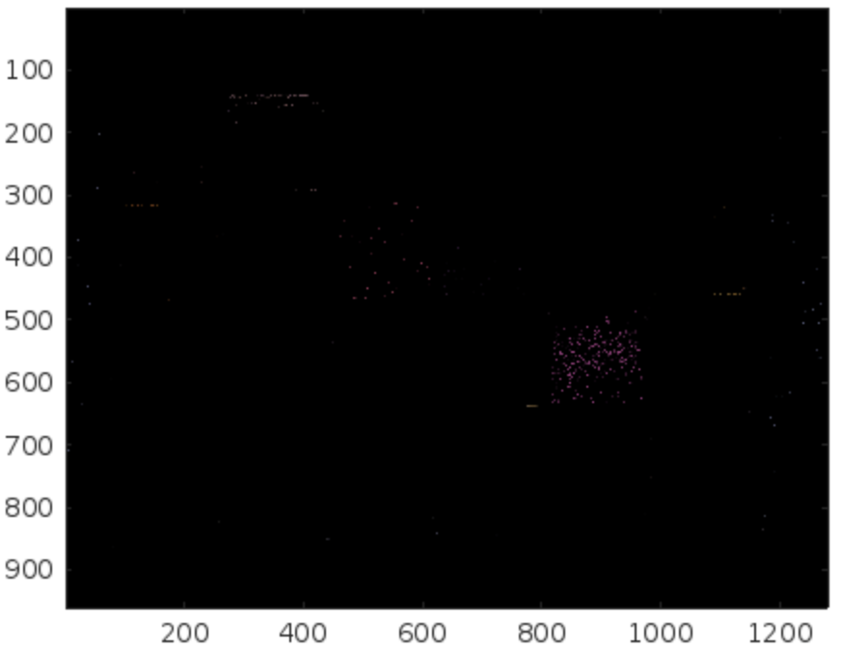

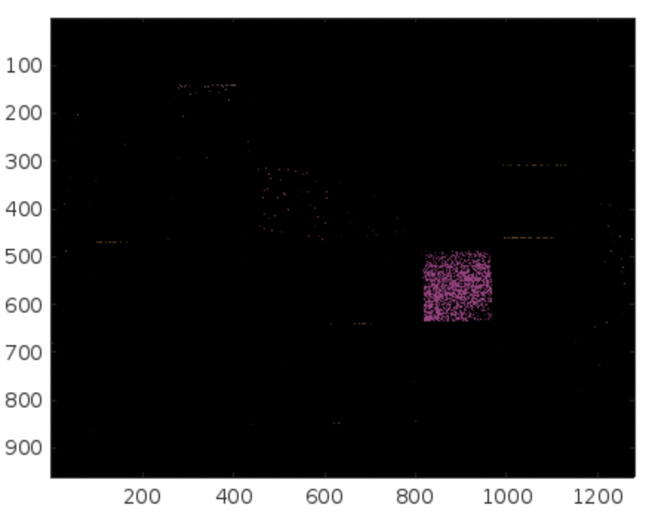
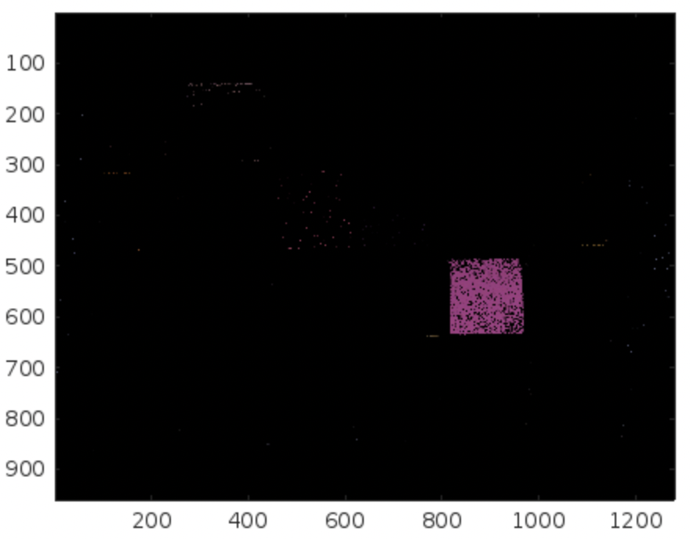
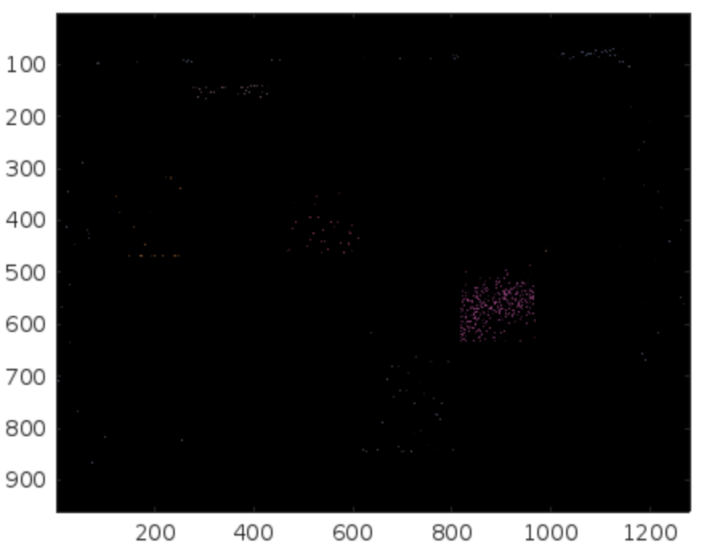
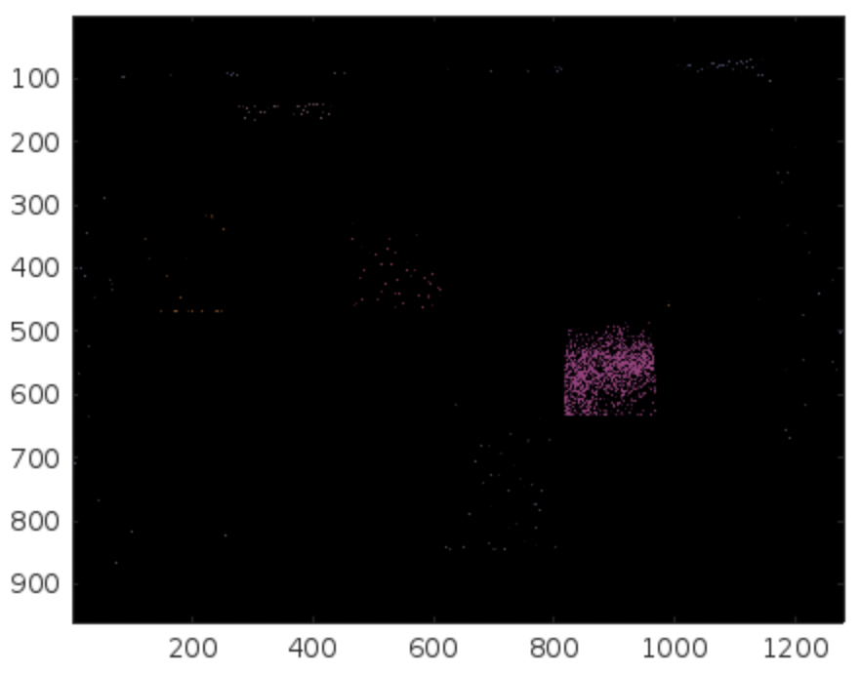
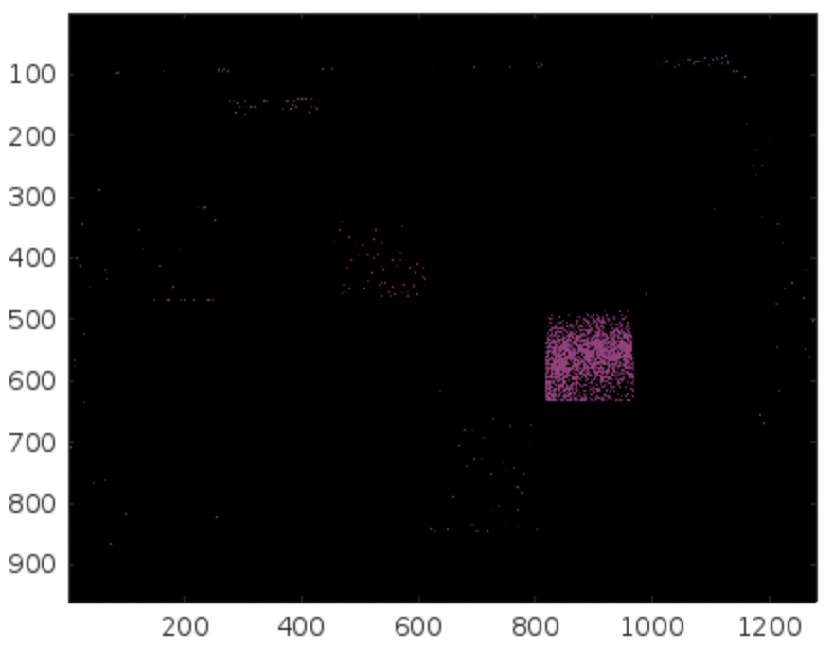
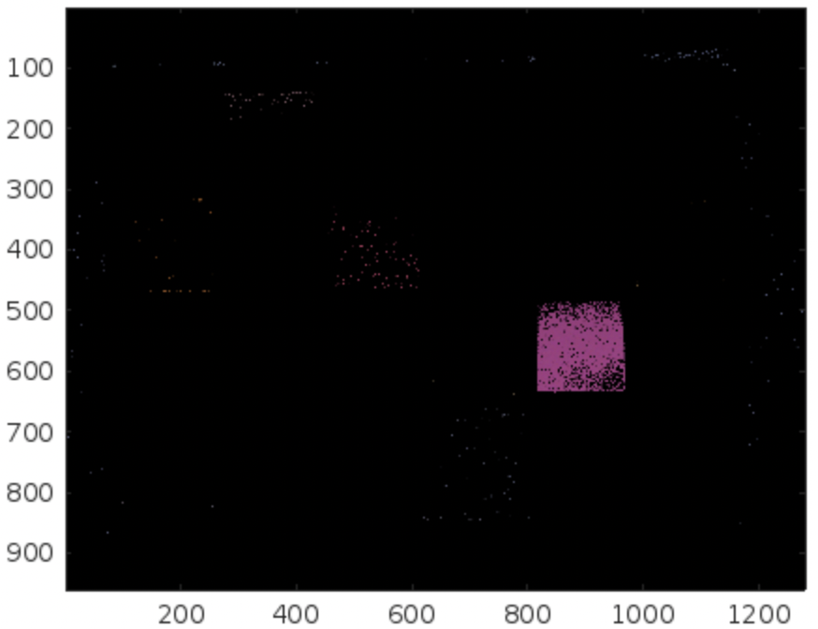
Method 2: Parametric Segmentation
Here is the result of 1D and 3D gaussian for varying scales:
As we can see, some of the probabilities are actually low that is why we didn’t get a good segmentation before. However, if we apply probability scaling, we can improve the segmented region.
p>0.8
p>0.5
p>0.1
p>0.1

Slide 12
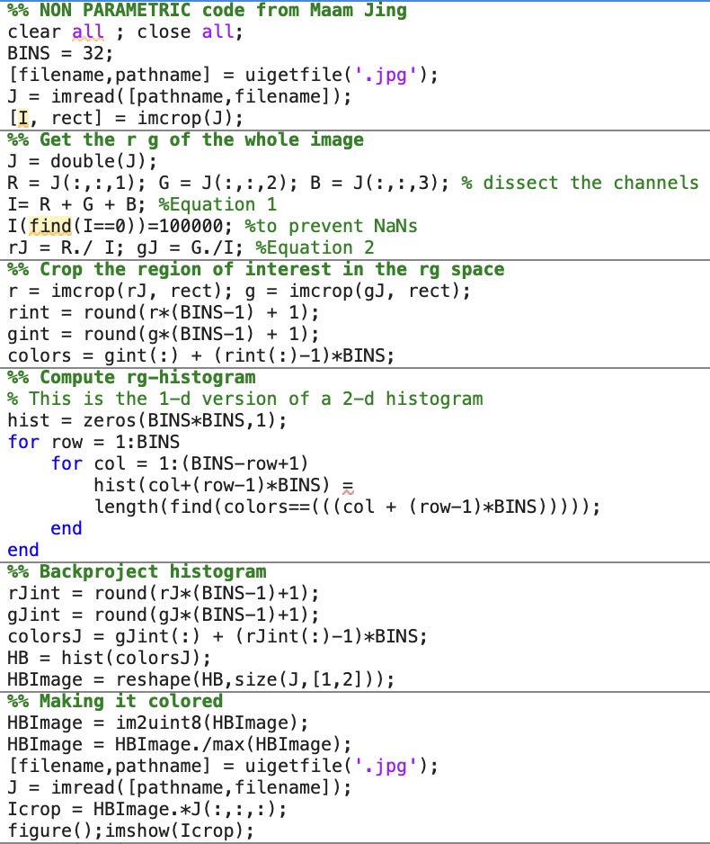
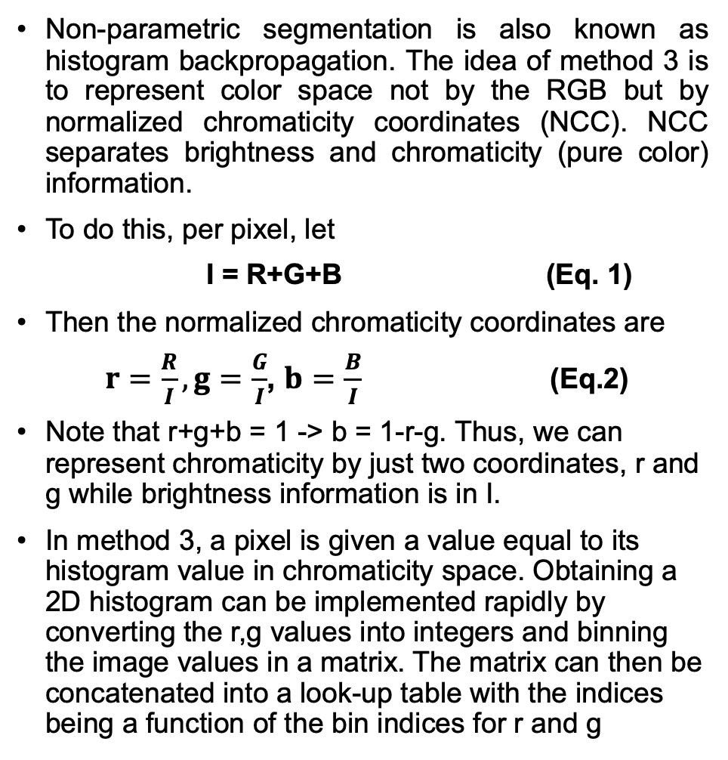
Method 3: Non-parametric Segmentation
Non-parametric segmentation is also known as histogram backpropagation. The idea of method 3 is to represent color space not by the RGB but by normalized chromaticity coordinates (NCC). NCC separates brightness and chromaticity (pure color) information.
To do this, per pixel, let
I = R+G+B (Eq. 1)
Then the normalized chromaticity coordinates are
$r=\frac{R}{I},g=\frac{G}{I}$, $b=\frac{B}{I}$ (Eq.2)
Note that r+g+b = 1 -> b = 1-r-g. Thus, we can represent chromaticity by just two coordinates, r and g while brightness information is in I.
In method 3, a pixel is given a value equal to its histogram value in chromaticity space. Obtaining a 2D histogram can be implemented rapidly by converting the r,g values into integers and binning the image values in a matrix. The matrix can then be concatenated into a look-up table with the indices being a function of the bin indices for r and g

Slide 13
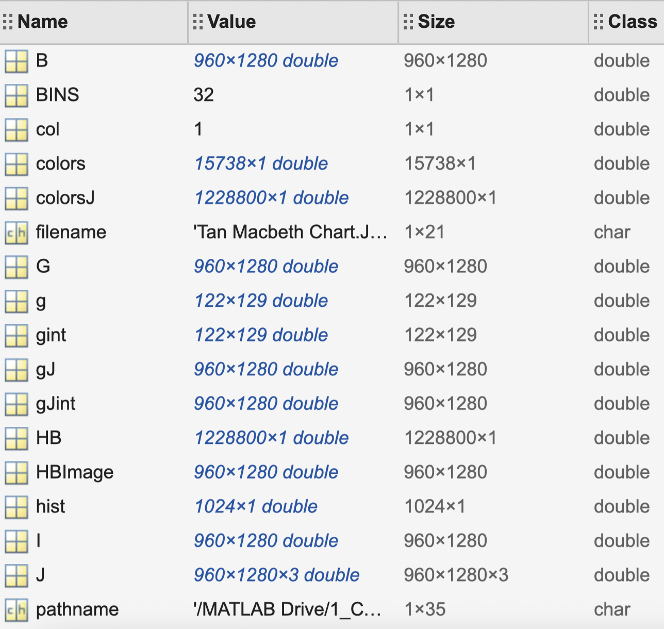
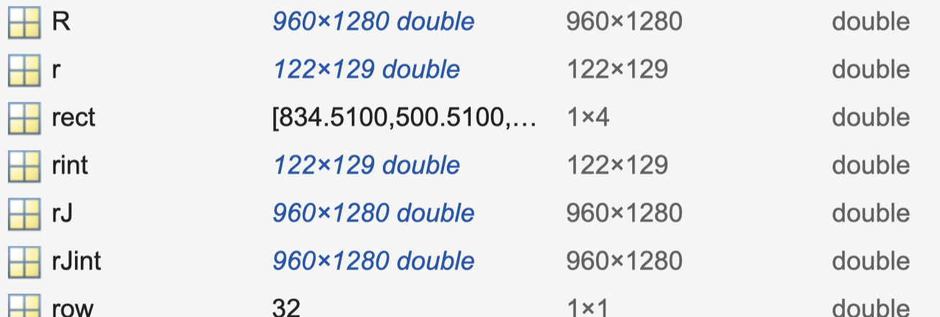
Method 3: Non-parametric Segmentation
Checking the workplace:

Slide 14
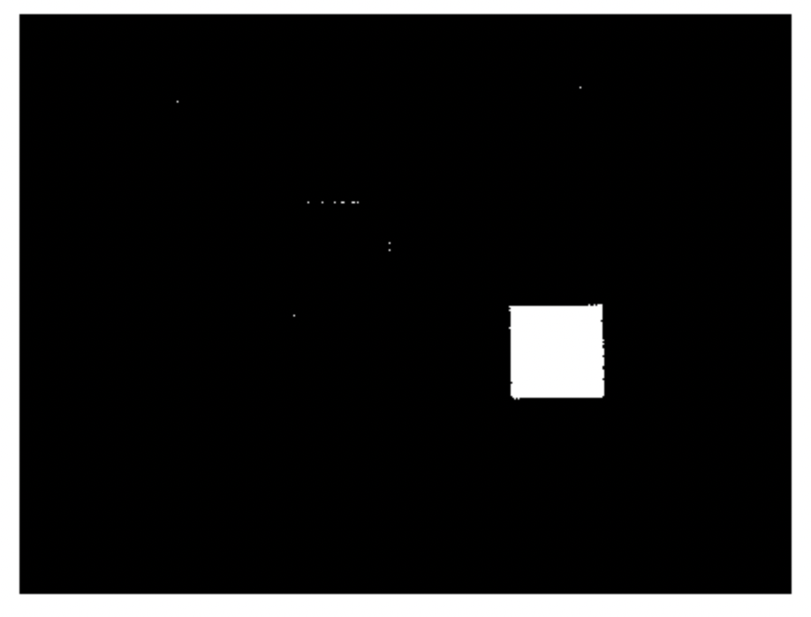

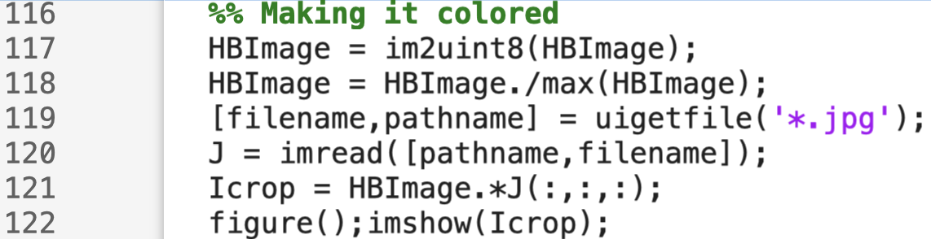
Method 3: Non-parametric Segmentation
Results:
Method 3 outperforms Method 1 and 2.
In turning it to it’s original color (pink), it is important to add line 119 to 120. We will not be able to generate the image without imposing this line.

Slide 15
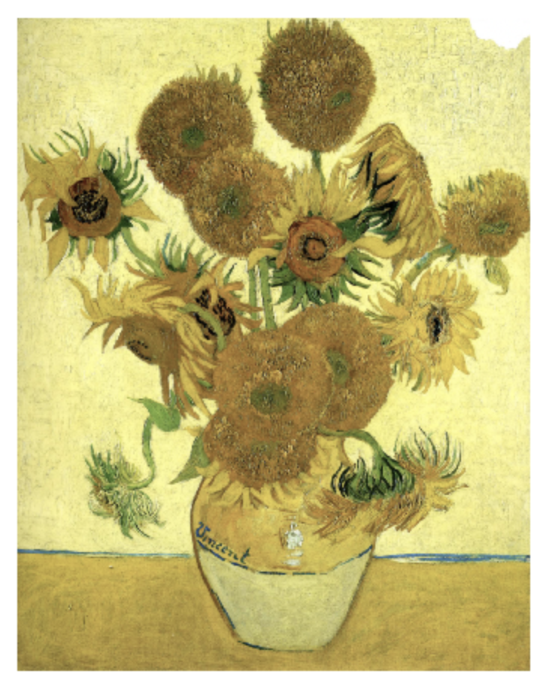
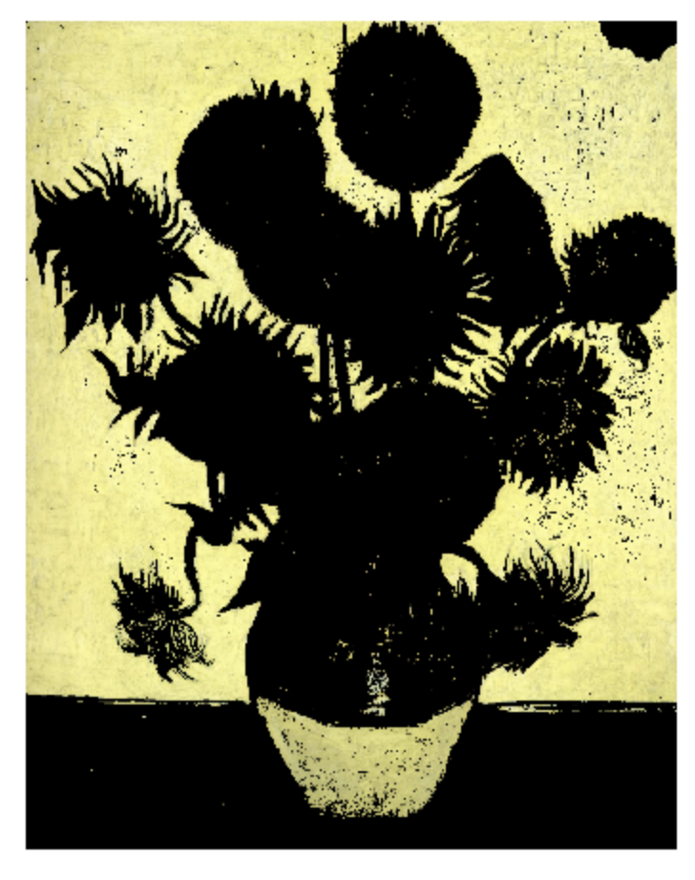
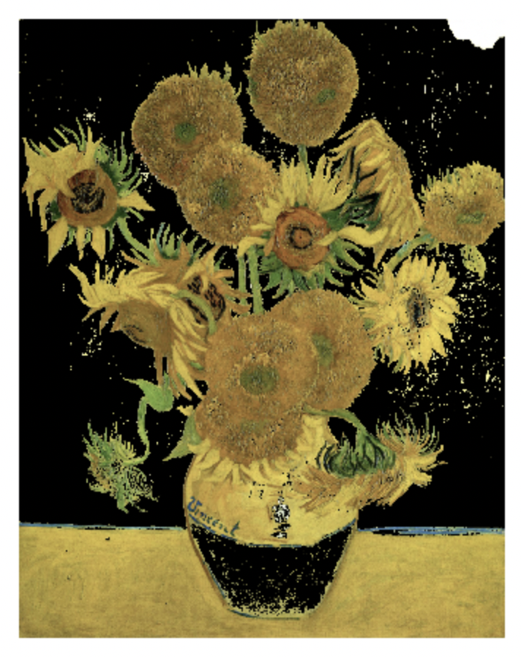
Now, let’s try it on more complex image! Let’s separate foreground and background of paintings
According to art experts, background sections of paintings bear the unconscious habitual movement of an artist, which will be useful to capture the artist’s unique style. With that, let’s try to separate the background from the foreground.
Here is the result for Method 1: Thresholding. I cropped the top left portion of the image.
Still Life - Vase with Fifteen Sunflowers by Vincent van Gogh
Date: 1888; Arles, Bouches-du-Rhône, France
Style: Post-impressionism
Genre: flower painting
Media: oil, canvas
Dimensions: 92.1 x 73 cm
Background (left) and foreground (right). To get the foreground, I inverse the logical operation BW = ~BW. It will be hard to get the foreground by cropping the regions of interest since there are many and it is not uniform.

Slide 16
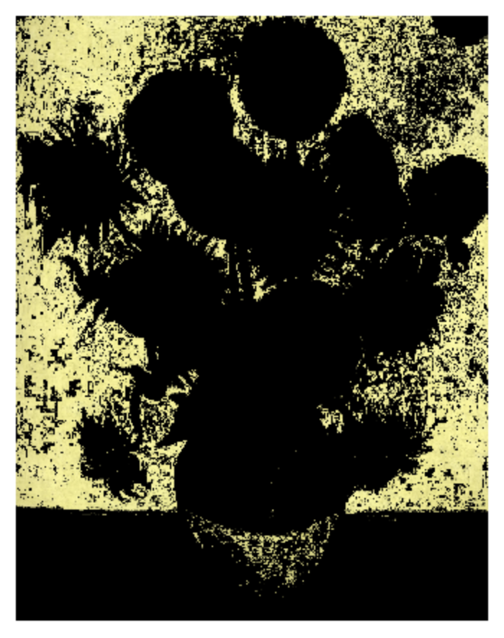
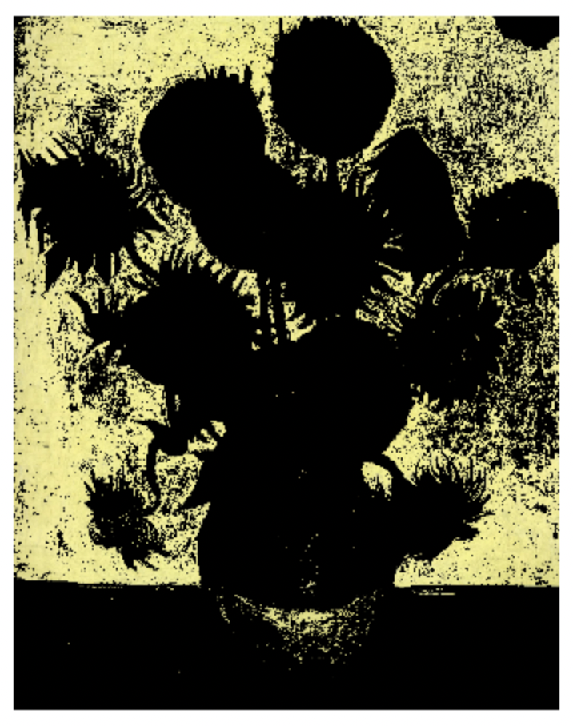
Now, let’s try it on more complex image!
Here is the result for Method 2: Parametric Segmentation for background. I applied the scaling here (p>0.1 will be scaled to 1) since without scaling, we only see faint version of the segmented region. Here, 1D Gaussian outperforms 3D Gaussian as expected.
Still Life - Vase with Fifteen Sunflowers by Vincent van Gogh
Date: 1888; Arles, Bouches-du-Rhône, France
Style: Post-impressionism
Genre: flower painting
Media: oil, canvas
Dimensions: 92.1 x 73 cm
3D Gaussian with scaling
1D Gaussian with scaling

Slide 17
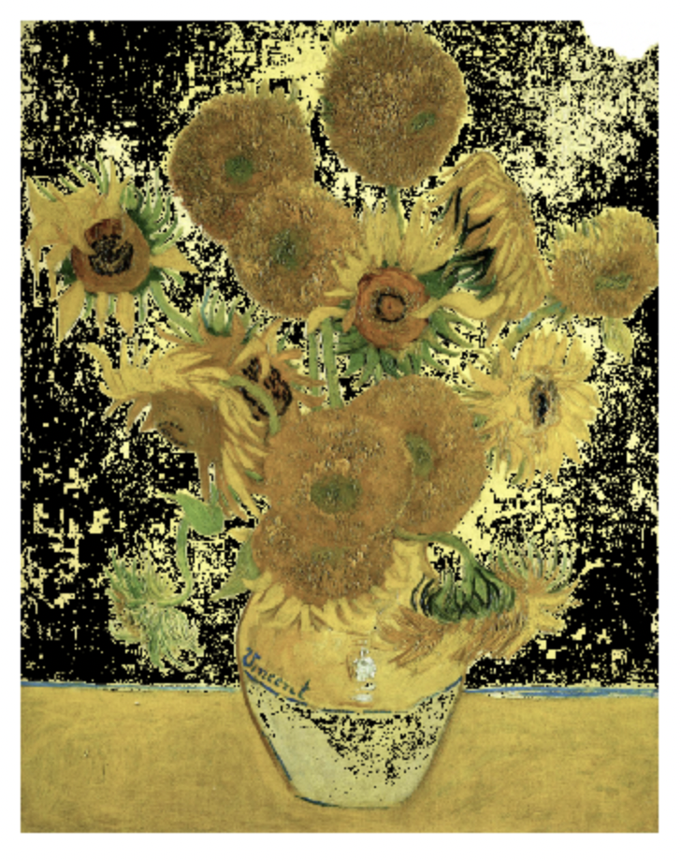
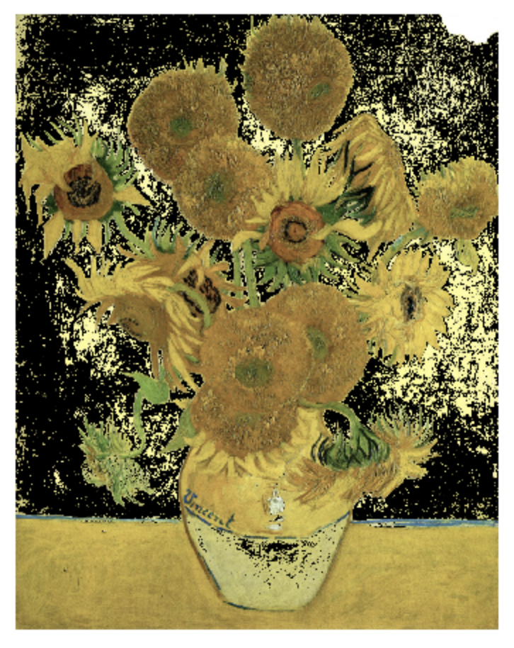
Now, let’s try it on more complex image!
Here is the result for Method 2: Parametric Segmentation for foreground. I inverse the scaling here - p<0.1 will be scaled to 1 instead of p<0.1.
Still Life - Vase with Fifteen Sunflowers by Vincent van Gogh
Date: 1888; Arles, Bouches-du-Rhône, France
Style: Post-impressionism
Genre: flower painting
Media: oil, canvas
Dimensions: 92.1 x 73 cm
3D Gaussian with scaling
1D Gaussian with scaling

Slide 18
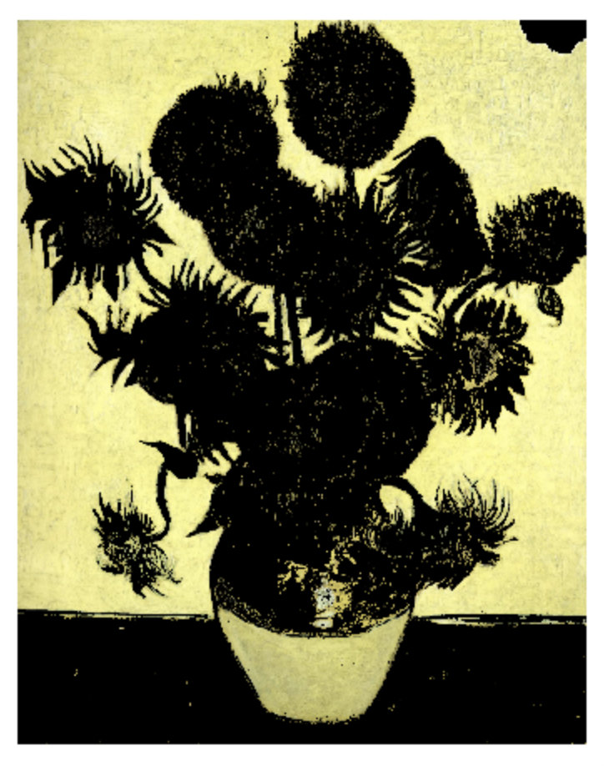
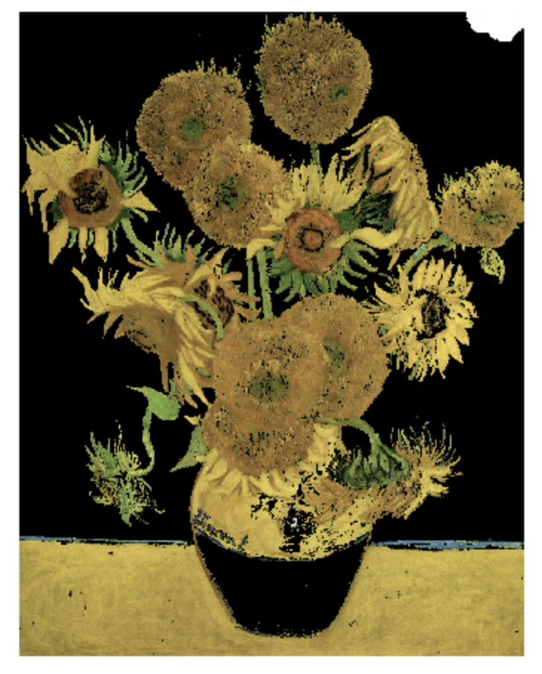
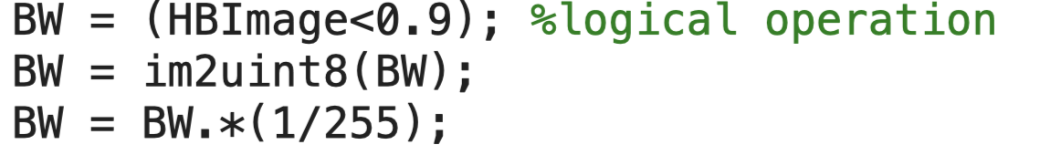
Now, let’s try it on more complex image!
Here is the result for Method 3: Non-parametric Segmentation. So far, it has the best result our of all the methods.
Still Life - Vase with Fifteen Sunflowers by Vincent van Gogh
Date: 1888; Arles, Bouches-du-Rhône, France
Style: Post-impressionism
Genre: flower painting
Media: oil, canvas
Dimensions: 92.1 x 73 cm
Background (left) and foreground (right). I inserted this logical operation to get the foreground:

Slide 19
Now, let’s try it on more complex image!
Method 1
Method 2 – 3D
Method 2 – 1D
Method 3
Qualitatively, Method 3 gave the best output, followed by Method 1, then Method 2. This observation is the same for both Macbeth and sunflower painting.

Slide 20

CRITERIA | QUALIFICATIONS | SCORE
Technical correctness | Met all objectives. Results are complete. Results are verifiably correct. Understood the lesson. | 30
Quality of presentation. | All text and images are of good quality. A picture or diagram of the setup is shown (if the activity has one). Code has sufficient comments and guides. All plots are properly labeled and are visually understandable. The report is clear. | 30
Reflection | Explained the validity of results. Discussed what went right or wrong in the activity. Justified the self score. Acknowledged sources (e.g. persons consulted, references, etc.) | 30
Ownership | Applied the technique on other data Discovered limitations in the technique Introduced improvements to the technique (scaling) | 10
100

